Slide 1
Laboratory: “Customized Embedded Processor Design for IoT”
Hussam Amrouch, Lars Bauer, Sajjad Hussain
(Lehrstuhl Prof. Dr. J. Henkel)
CES - Chair for Embedded Systems
KIT - Karlsruhe Institute of Technology, Germany

Slide 2
Internet of Things (IoT)
Internet of Things (IoT) covers an ever-increasing range of applications.
The design of embedded processors, especially for IoT, has experienced significant progress.
This development has been characterized by the increasing demand for application-specific solutions for IoT in order to fulfil the diverse and contradictory requirements of low power consumption, high performance, low cost and most importantly an efficient time-to-market deployment of those processors.

Slide 3
ASIPs: efficiency vs. flexibility
“Hardware solution”
ASIC:
- Non-programmable,
- highly specialized
The best performance
The highest development cost
Only reasonable for high volume products
ASIP
(extensible
processor)
- instruction extension/definition
“efficiency”: MIPS/$, MHz/mW, MIPS/area, …
- parameterization
inclusion/non-inclusion of
functionality/devices
General purpose
processor
“Software
solution”
Flexibility, 1/time-to-market, …
src: Henkel “Design and Architectures for Embedded Systems (ESII)”

Slide 4
ASIPs: efficiency vs. flexibility
“Hardware solution”
ASIC:
- Non-programmable,
- highly specialized
ASIP
(extensible
processor)
- instruction extension/definition
“efficiency”: MIPS/$, MHz/mW, MIPS/area, …
- parameterization
Extremely flexible
Bad performance
inclusion/non-inclusion of
functionality/devices
General purpose
processor
“Software
solution”
Flexibility, 1/time-to-market, …
src: Henkel “Design and Architectures for Embedded Systems (ESII)”

Slide 5
ASIPs: efficiency vs. flexibility
“Hardware solution”
ASIC:
- Non-programmable,
- highly specialized
ASIP
(extensible
processor)
- instruction extension/definition
“efficiency”: MIPS/$, MHz/mW, MIPS/area, …
- parameterization
inclusion/non-inclusion of
functionality/devices
Optimized for an application
Still flexible, but achieves a better performance
“Software
solution”
General purpose
processor
Flexibility, 1/time-to-market, …
src: Henkel “Design and Architectures for Embedded Systems (ESII)”

Slide 6
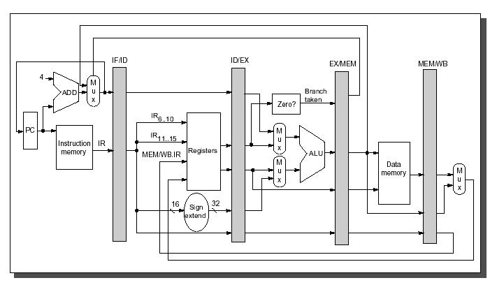
Pipeline Processor
src: Muhammad Shaaban “The DLX Architecture”, lecture on ‘Computer Architecture’

Slide 7
Pipelining

Slide 8
Pipeline Processor Used
Parameters | Architecture
Basic architecture | RISC
Memory architecture | Harvard
Instruction length | 32
Data length | 32
Addressing | Byte address
The number of general-purpose registers | 32
The number of pipeline stages | 4
The number of delayed branch slot | 0
Floating-point unit | N/A
Forwarding | full forwarding
Alignment | 1-byte, 2-byte and 4-byte
Endian-ness | Big Endian
Interrupts | Reset, Internal, External
Brownie STD 32 is a RISC-type pipeline processor architecture. The Brownie architecture is designed for an easy and fast pipeline processor. It is a Load-/Store-architecture,

Slide 9
Goal of ASIP Lab
Creating new CPUs with new instructions and implementing these new instructions in Hardware and Software with evaluation and testing
The main goals are:
creating new ASIPs for special applications
benchmark those ASIPs to find out their benefits and drawbacks
and finally to interpret the benchmark results

Slide 10
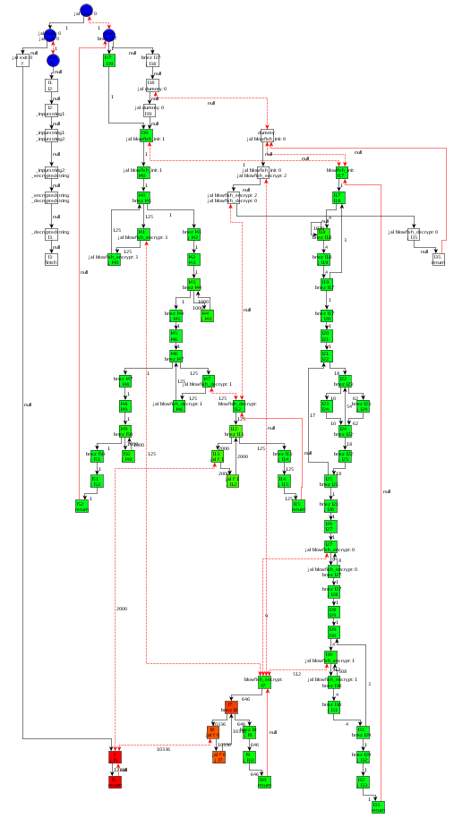
Profiling on Control-Flow Graph
Each node is a Base Block:
The instructions in a Base Block are always executed together
No jumps in a Base Block, except the end
No jump targets in a Base Block, except the beginning
Blowfish with 1 KB input data: Encrypt and Decrypt

Slide 11
Constraints for Designing Custom Instructions
Number of Input-/Output-Values to Custom Instruction
Limited by register file, e.g. 4 read and 2 write ports
‘Forbidden Nodes’, e.g. Load/Store
Convex Graph
Limited Frequency, Area, Power, and/or Energy Budget
An ASIP that consumes more power may consume less energy, if the application terminates much earlier
load

Slide 12
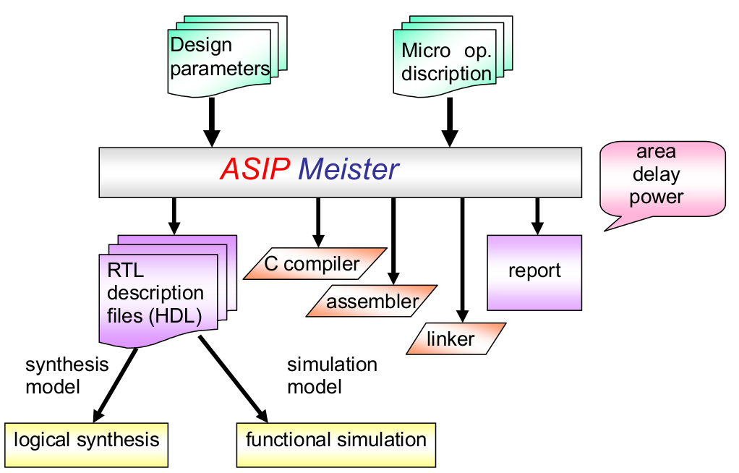
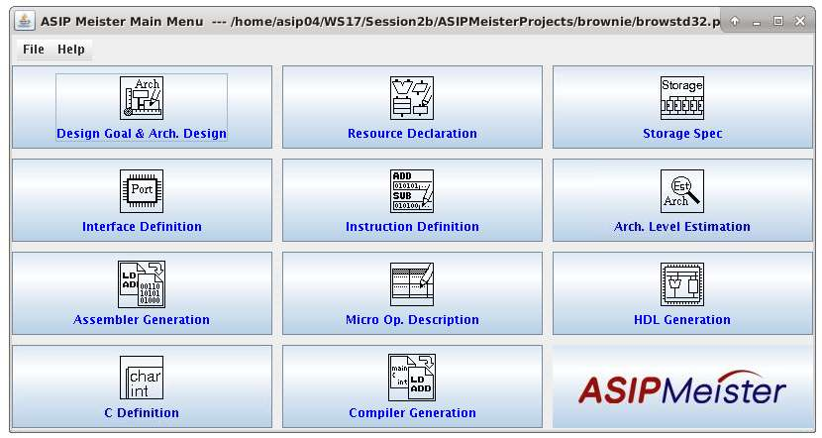
Tasks in ASIP Lab
Programming in assembly language
Implementing new instructions with ASIP Meister (+Simulation, +Hardware)
Evaluating the results from the new CPU
designing new instructions for large applications with testing
Creating different CPU versions
Fig.1 ASIPmeister Software
Fig. 2 ASIP Meister Input and Output

Slide 13
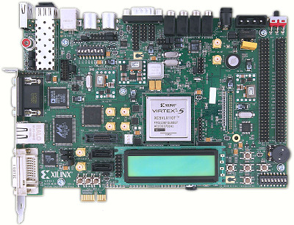
Lab Environments
dlxsim: Simulator for DLX-Assembler
ASIPMeister: To create new processor
Extended GCC compiler: compiler out of an processor architecture description in ASIPMeister.
ModelSim: simulator for VHDL-Code
Xilinx ISE: Synthesis of VHDL-Code
XPower: To estimate power consumption
Virtex-5 FPGA Evaluation Board

Slide 14
Important Directories
/home/asip00/epp:
The required programs for the Lab are often used automatically by scripts
/home/asip00/ASIPMeisterProjects/TEMPLATE_PROJECT
New version of Lab scripts
Project example with application example
/home/asip00/Sessions/SessionX: The requirements for each session
For instance, you can find the slides and the Lab Script in ~/epp/Sessions/Session0
Before each session is started, the corresponding material will be copied to its folder.
/home/asip00/Documents/: The relevant tutorials and manuals for the Lab.

Slide 15
Important Documents
Following is used as reference material. In each session, only the relevant chapters are asked to read. No need to go through all these.
Laboratory Script
ASIPMeister Users’ Manual (AM_usersmanual_en.pdf)
ASIPMeister Tutorial (AM_tutorial_en.pdf)
Brownie STD 32 Reference Manual (BrownieSTD32_Spec_en.pdf)
Brownie STD 32 Package ReadMe.txt (README_en.txt)
Using the GNU Compiler Collection (Compiler.pdf)
The GCC Assembler (GCC Assemble.pdf)
The GNU linker (linker.pdf)

Slide 16
Important Note
Generally, the sessions need to be executed on one of the following Lab PCs:
i80labpc01, i80labpc02, … i80labpc10
ASIPmeister is ALWAYS executed from i80pc57. This PC can be SSH-ed from any of above PCs i.e. i80labpcXX or from your laptop.
FPGA JTAG driver is setup on i80labpc10, and FPGA board can be connected to this PC only.
To avoid compatibility issues between the Software tools and the OS
For remote access use ssh username@i80labpc01.ira.uka.de

Slide 17
General Information
Computer-Accounts (Ubuntu 12.04)
ASIPmeister PC i.e. i80pc57 (CentOS 5)
For the first session, read chapter 3 (dlxsim; without 3.2.2, 3.2.3 & 3.3.2)
For the second session, read chapter 2 (working environment), 8 (using the compiler) and 5 (ModelSim)
Now: Accounts & Linux-Tutorial (chapter 2.2)

Slide 18
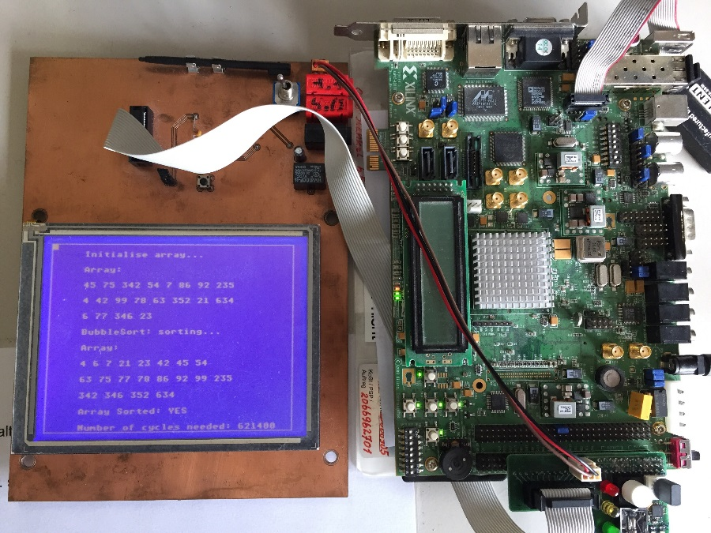
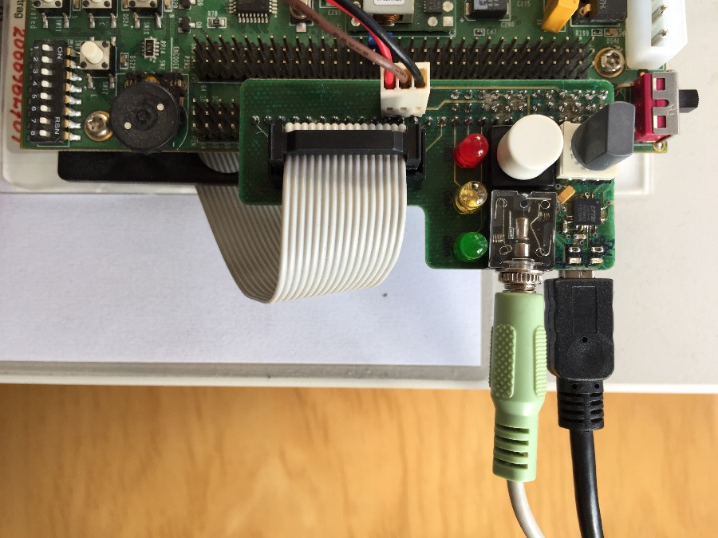
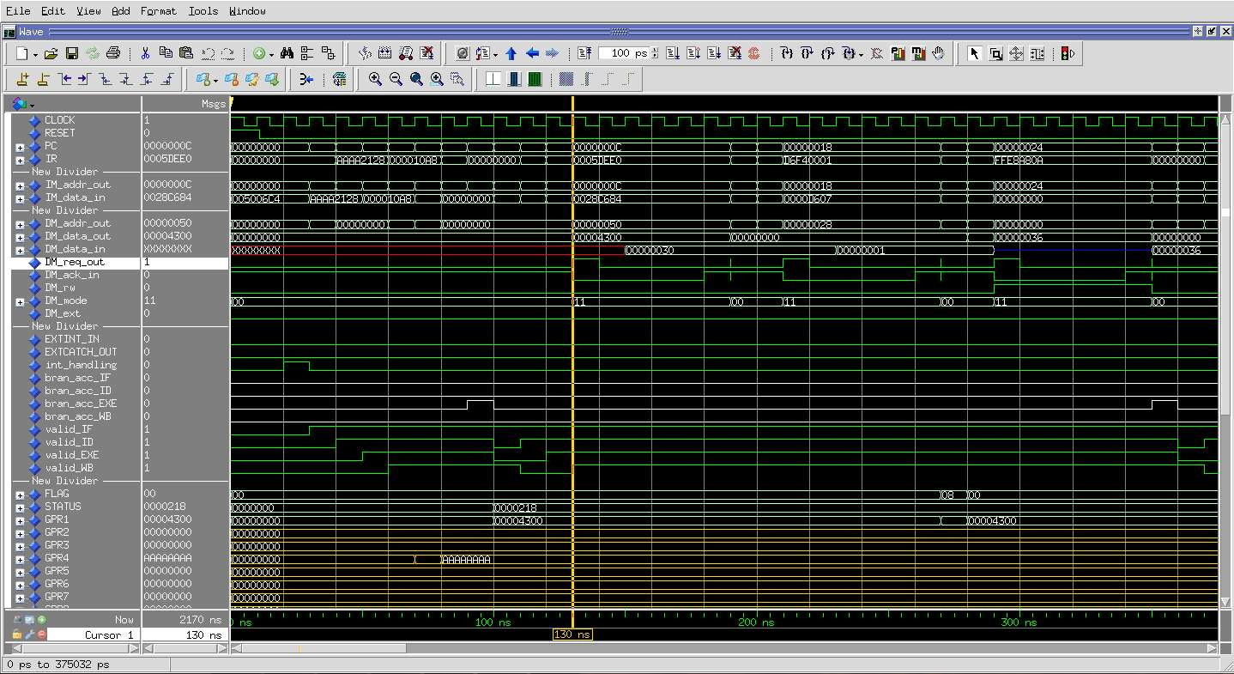
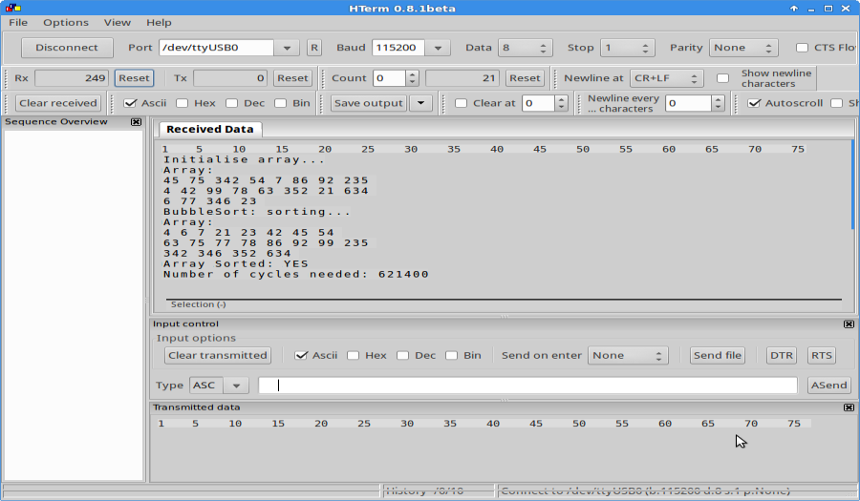
Bubble Sort Example
ASIP Lab Hardware Virtex-5 Setup
Peripheral Board Connections
CPU Signals (ModelSim Simulation)
Output to UART hterm

Slide 19
Supervisors and the regular meeting
Dr. Hussam Amrouch
Dr. Lars Bauer
Sajjad Hussain
Regular Meeting: what about Monday 14:00 ?
Questions??

